Slide 1

ELECTRIC DIFFERENTIAL SYSTEM FOR THREE-WHEELED ELECTRIC VEHICLE
Guided by Team:
Dr. Mohammed Mansoor O Abi Ijlan (6)
Associate Professor Anand A (16)
Department of Electrical And Electronics Ameen Yehiya (12)
Joan Hanna James (34)

Slide 2
Content
Introduction
Objective
Literature Review
Problem Statement
Methodology
Mathematical Model
Result
Conclusion
Scope and Future
Reference

Slide 3
Introduction
EVs are the future of vehicles.
Tri-wheelers are designed for individuals with disability, offering enhanced control and maneuverability.
Tri-wheelers face several issues, including stability concerns, speed limitations, compatibility, and safety challenges.

Slide 4
Objective
To enhanced maneuverability
To improve traction control
To improve energy efficiency

Slide 5
Literature Review
Sl.No | Journal Name | Highlights
1 | Bo-Chiuan Chen,"Design of an Electric Differential System for Three-Wheeled Electric Welfare Vehicles With Driver-in-the-Loop Verification" in IEEE Transactions on Vehicular Technology · August 2007 | Traditional differentials in three-wheeled vehicles struggle with torque distribution during cornering, increasing steering effort​ The EDS allows independent control of wheel speeds, improving handling and reducing steering torque​ Simulations show EDS significantly reduces steering torque and roll angles, enhancing stability, especially at low speeds​
2 | Akshay Agarwal, "Electrical Differential in Electric Vehicle", in International Journal of Scientific and Engineering Research · November 2013,SRM Institute of Science and Technology. | Replaces the mechanical differential by independently controlling wheel torque and speed during turns Uses a PID controller to adjust wheel speeds in real-time based on steering and throttle inputs​ ED is lighter, more efficient, and reduces vehicle weight compared to mechanical systems​

Slide 6
Problem Statement
To develop a mathematical model that describes the relationship between the steering angle (input) and the speeds of the rear wheels (output) in a tri wheeler

Slide 7
Methodology
Ackerman Geometry
A steering principle that adjusts wheel angles during turns, ensuring that each wheel follows its correct path.
Essential for improving stability in three-wheeled vehicles, where maintaining balance is more challenging than in four-wheeled configurations.
Helps reduce tire slip, improving traction control, enhancing handling precision and safety.

Slide 8
Mathematical Model
R: Radius of the turning circle of the vehicle.
w: Track width (distance between the left and right wheels).
L: Wheelbase (distance between the front and rear axles).
θ : Steering angle of the front wheel.
Rᵢ: Radius of the turning circle for the inside wheel.
Rₒ: Radius of the turning circle for the outside wheel.
vₒ: Velocity of the outside wheel.
vᵢ: Velocity of the inside wheel.
ω: Angular velocity of the vehicle.

Slide 9
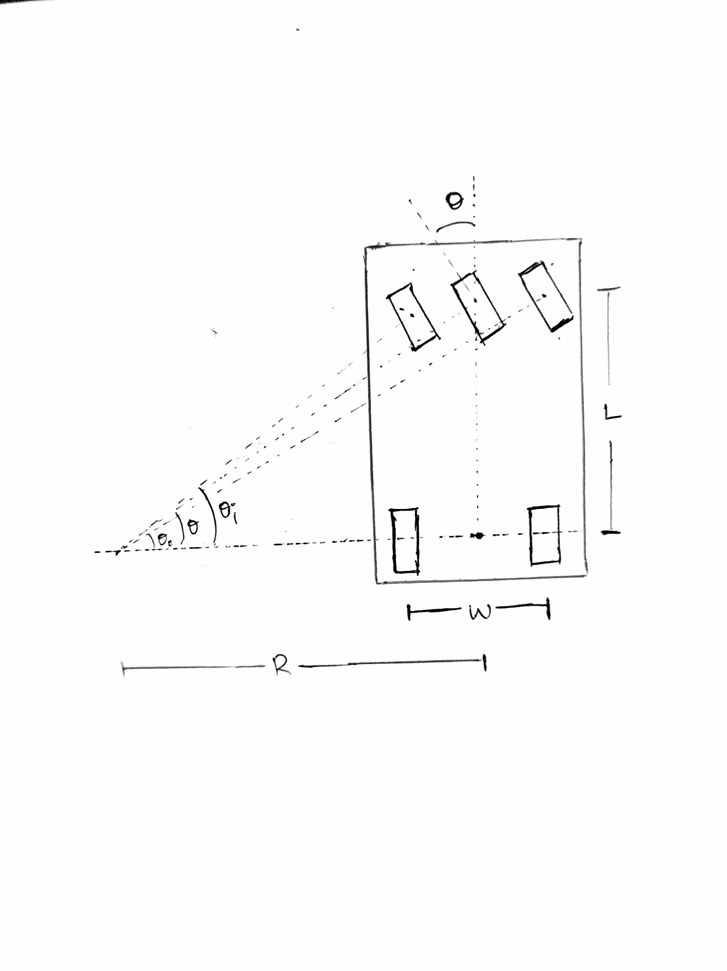
From figure, Steering angle:
tan θ = L / R
Wheel turning radii,
Rᵢ = R - w/2
Rₒ = R + w/2
From,
vₒ/ vᵢ= Rₒ/ Rᵢ
Velocity of wheels,
vₒ = ω Rₒ= ω(R - w/2)
vᵢ = ω Rᵢ = ω(R + w/2)

Slide 10
Expressing radii in terms of velocities vₒ and vᵢ,
R = vₒ / ω - w/2
R = vᵢ / ω + w/2
Steering angle in terms of velocities vₒ and vᵢ,
tan θ = L
(vₒ / ω - w/2)
tan θ = L
(vᵢ / ω + w/2)
Velocities of the Wheels Based on Steering Angle:
vₒ = ω (L / tan(θ) + w/2)
vᵢ = ω (L / tan(θ) - w/2)

Slide 11
Result
The following equations governing the speed of the rear wheel of a Tri wheeler as function of steering angle is formed.
vₒ = ω (L / tan(θ) + w/2)
vᵢ = ω (L / tan(θ) - w/2)

Slide 12
Conclusion
By integrating Ackerman geometry into the electric differential system, we can solve critical issues in stability, handling, and steering effort for three-wheeled EV’s.

Slide 13
Scope And Future
Implement a controller to adjust rear wheel speeds dynamically based on the steering angle.
Test the system in real-world conditions to further refine performance.

Slide 14
REFERENCE
[1] S.-Y. Jiang, "Controller Design and Implementation of the Electrical Differential," M.S. thesis, Dept. Mech. Eng., National Taiwan Univ., Taipei, Taiwan, 1996.
[2] U. Chong, E. Namgoong, S.-K. Sul, "Torque Steering Control of 4-wheel Drive Electric Vehicle," in IEEE Workshop on Power Electronics in Transportation, Dearborn, MI, 1996, pp. 159-164.
[3]Akshay Agarwal, "Electrical Differential in Electric Vehicle"in International Journal of Scientific and Engineering Research · November 2013, SRM Institute of Science and Technology.

Slide 15
THANK YOU

